Slide 1
BIG MART SALES PREDICTION
By: Pragya Sinha

Slide 2
Contents
Problem statement
Target Audience
Datasets used for the investigation
Data cleaning and wrangling
Data Visualisation and Exploratory data analysis
Machine learning algorithms
Conclusion

Slide 3
Problem Statement
Day by day competition among different shopping malls as well as big marts is getting more serious and aggressive only due to the rapid growth of the global malls and online shopping. Every mall or mart is trying to provide personalized and short-time offers for attracting more customers depending upon the day, such that the volume of sales for each item can be predicted for inventory management of the organization, logistics and transport service, etc. Present machine learning algorithm are very sophisticated and provide techniques to predict or forecast the future demand of sales for an organization, which also helps in overcoming the cheap availability of computing and storage systems. In this paper, we are addressing the problem of big mart sales prediction or forecasting of an item on customer’s future demand in different big mart stores across various locations and products based on the previous record. Different machine learning algorithms like linear regression analysis, random forest, etc are used for prediction or forecasting of sales volume. As good sales are the life of every organization so the forecasting of sales plays an important role in any shopping complex. Always a better prediction is helpful, to develop as well as to enhance the strategies of business about the marketplace which is also helpful to improve the knowledge of marketplace. A standard sales prediction study can help in deeply analyzing the situations or the conditions previously occurred and then, the inference can be applied about customer acquisition, funds inadequacy and strengths before setting a budget and marketing plans for the upcoming year. In other words, sales prediction is based on the available resources from the past. In-depth knowledge of the past is required for enhancing and improving the likelihood of marketplace irrespective of any circumstances especially the external circumstance, which allows preparing the upcoming needs for the business. Extensive research is going on in retailers' domain for forecasting the future sales demand. The basic and foremost technique used in predicting sales is the statistical methods, which is also known as the traditional method, but these methods take much more time for predicting sales also these methods could not handle nonlinear data so to over these problems in traditional methods machine learning techniques are deployed. Machine learning techniques can not only handle non-linear data but also huge data-set efficiently. To measure the performance of the models, Root Mean Square Error (RMSE), cross-validation is used

Slide 4
Target Audience
The model can be used by the company to predict the sales for their outlet. This analyses different parameters and check which factors affects the sale more
So, we are here to explain our model to the company employees and the finance team how this model will work

Slide 5
Dataset
In our work we have used 2013 Sales data of Big Mart as the dataset. Where the dataset consists of 12 attributes like Item Fat, Item Type, Item MRP, Outlet Type, Item Visibility, Item Weight, Outlet Identifier, Outlet Size, Outlet Establishment Year, Outlet Location Type, Item Identifier and Item Outlet Sales. Out of these attributes response variable is the Item Outlet Sales attribute and remaining attributes are used as the predictor variables. The data-set consists of 8523 products across different cities and locations. The data-set is also based on hypotheses of store level and product level. Where store level involves attributes like: city, population density, store capacity, location, etc and the product level
hypotheses involves attributes like: brand, advertisement, promotional offer, etc. After considering all, a dataset is formed and finally the data-set was divided into two parts, training set and test set in the ratio 80 : 20.

Slide 6
Data Wrangling
It was observed from the previous section that the attributes Outlet Size and Item Weight has missing values. In our work in case of Outlet Size missing value we replace it by the mode of that attribute and for the Item Weight missing values we replace by mean of that particular attribute. The missing attributes are numerical where the replacement by mean and mode diminishes the correlation among imputed attributes. For our model we are assuming that there is no relationship between the measured attribute and imputed attribute.

Slide 7
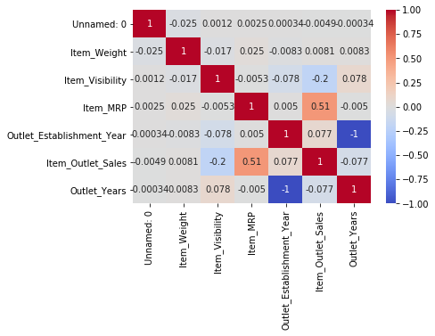
EDA and data visualization
After all the analysis and visualization we get to know that ITEM MRP is strong correlated with the output sales

Slide 8
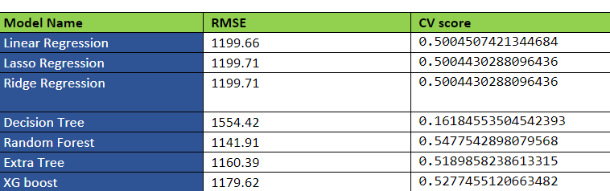
Modelling

Slide 9
Conclusion
Random Forest is used for prediction with least RMSE and also Item_MRP is the variable which affects the most
The predicted dataset is available in the github

